Slide 1
Tough Topics: Class 4
How Should Christians Think About Islam?

Slide 2
Roadmap
What is Islam?
Radical Islam and the West
What can Christians do?

Slide 3
How did Islam start?

Slide 4
How did Islam start?
Muhammad
Schism
a. Sunnis: supported Abu Bakr
b. Shias: supported Ali
Spread

Slide 5
What does Islam teach?

Slide 6
What does Islam teach?
Five pillars
a. Faith (Shahada)
b. Prayer (Salat)
c. Almsgiving (zakāt)
d. Fasting (ṣawm)
e. Pilgrimage (Hajj)

Slide 7
What does Islam teach?
Christianity and Islam compared
a. God: Yahweh vs. Allah
Tawhid: Islamic doctrine of Allah’s oneness
Trinity: Christian doctrine that God is three persons sharing one substance

Slide 8
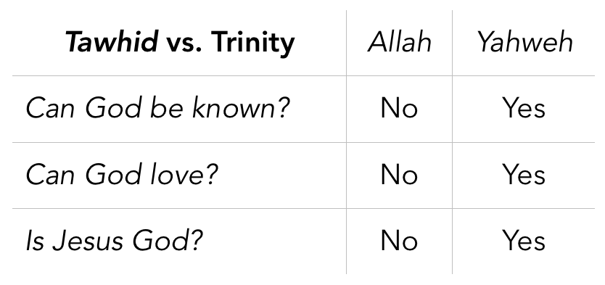

Slide 9
What does Islam teach?
Christianity and Islam compared
a. God: Yahweh vs. Allah
Tawhid: Islamic doctrine of Allah’s oneness
Trinity: Christian doctrine that God is three persons sharing one substance
b. Founders: Jesus vs. Muhammad
Hadith: Islamic doctrine of Allah’s oneness

Slide 10
Qur’an 4.157: “They did not kill him, nor did they crucify him, though it was made to appear like that to them”

Slide 11
What does Islam teach?
Christianity and Islam compared
a. God: Yahweh vs. Allah
Tawhid: Islamic doctrine of Allah’s oneness
Trinity: Christian doctrine that God is three persons sharing one substance
b. Founders: Jesus vs. Muhammad
Hadith: Islamic doctrine of Allah’s oneness
c. Scriptures: Qur’an vs. the Bible

Slide 12
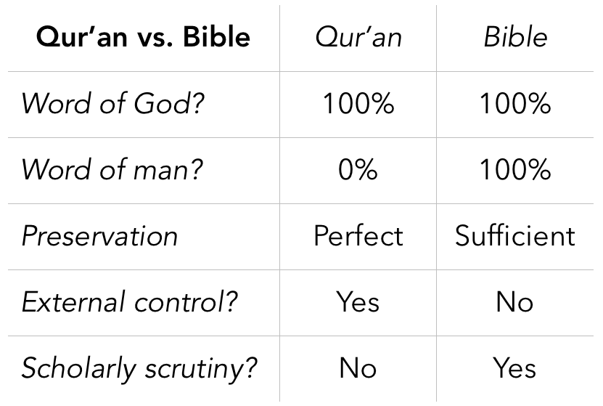

Slide 13
Roadmap
What is Islam?
Radical Islam and the West
What can Christians do?

Slide 14
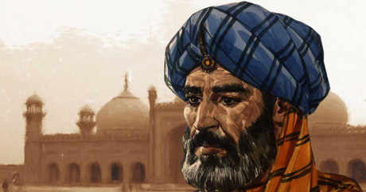
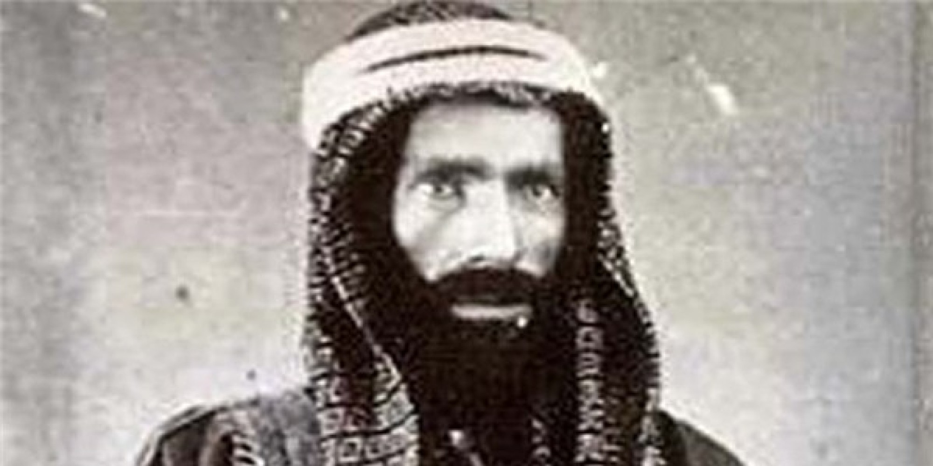
Modern Radical Islam: Influences
Right: [Portrayal of] Ibn Taymiyyah (1263-1328)
Left: [Portrayal of] Muhammad ibn Abd al-Wahhab (1703-1792)

Slide 15
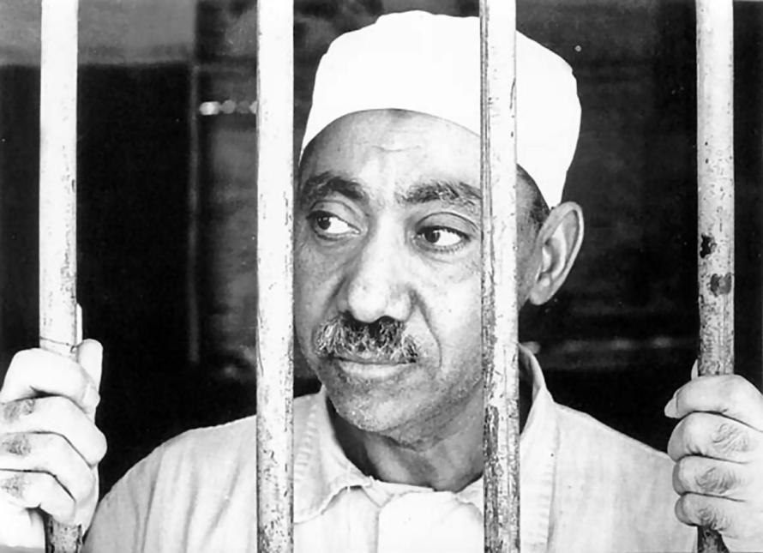
Modern Radical Islam: Founder
Sayyid Qutb (1906-1966)

Slide 16
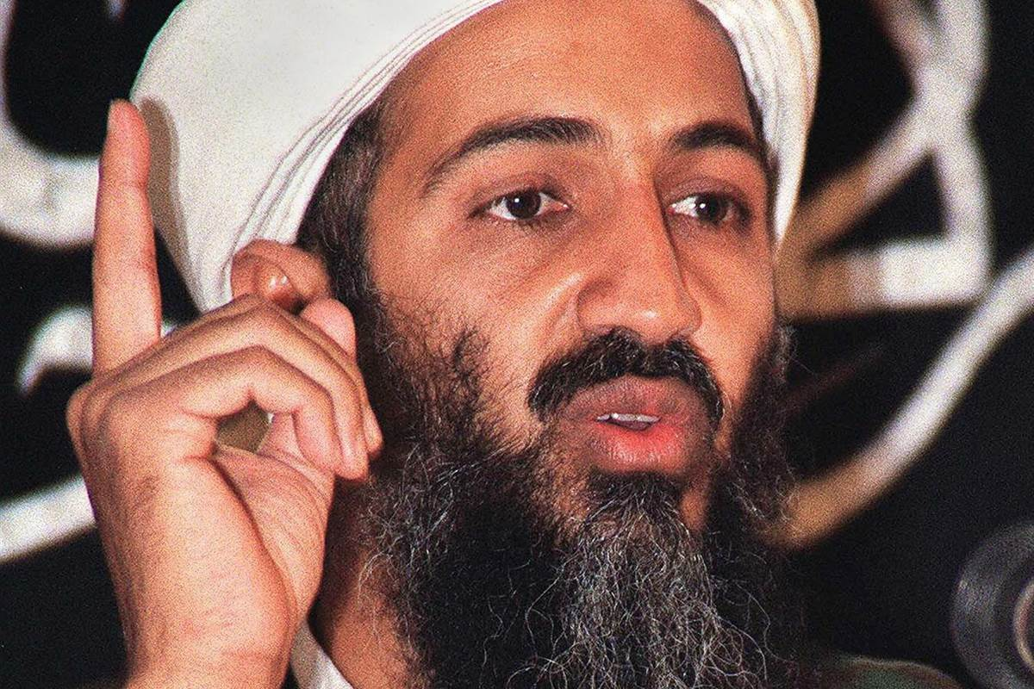
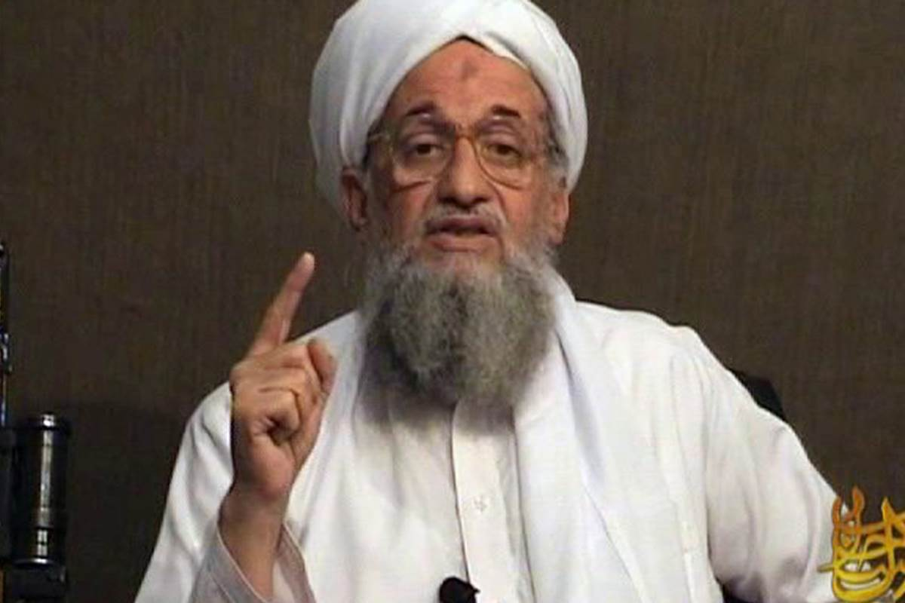
Modern Radical Islam: Practitioners
Osama bin Laden
Ayman al-Zawahiri

Slide 17
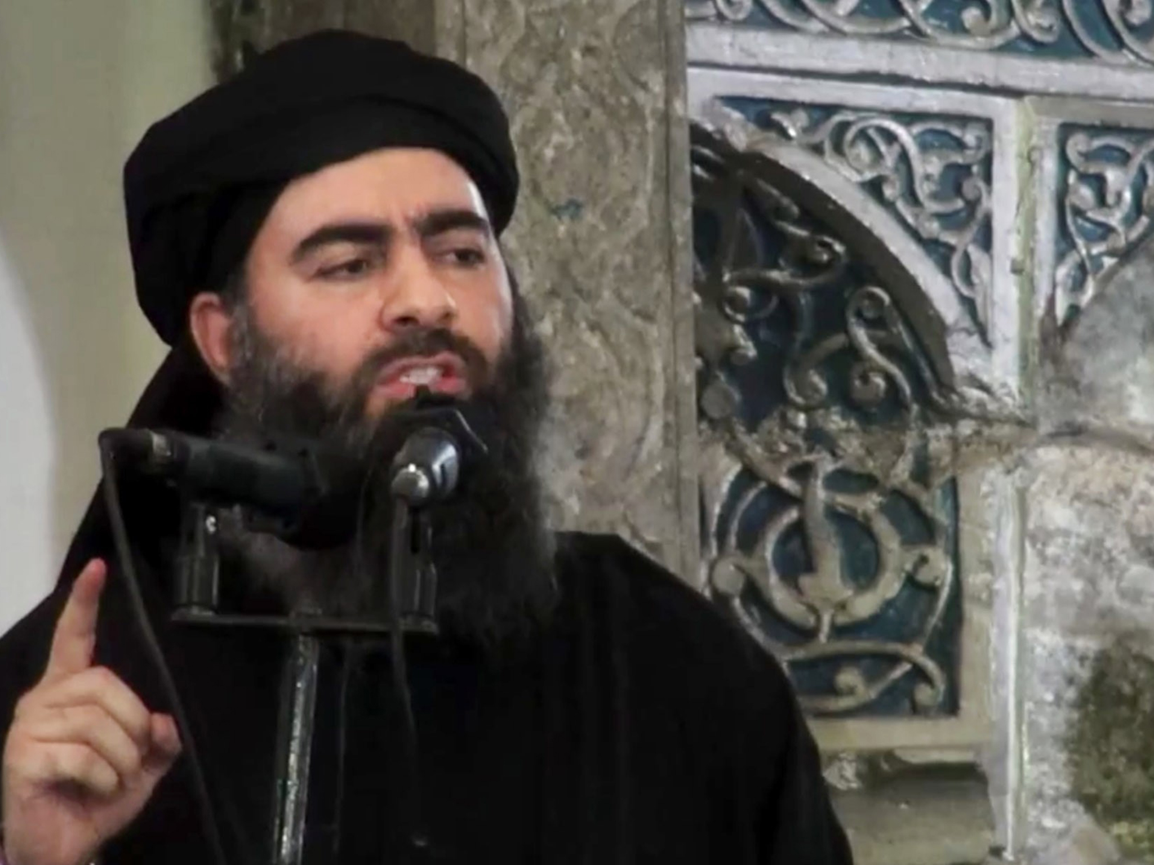
Modern Radical Islam: Practitioners
Abu Bakr al-Baghdadi (ISIS)

Slide 18
An example…

Slide 19
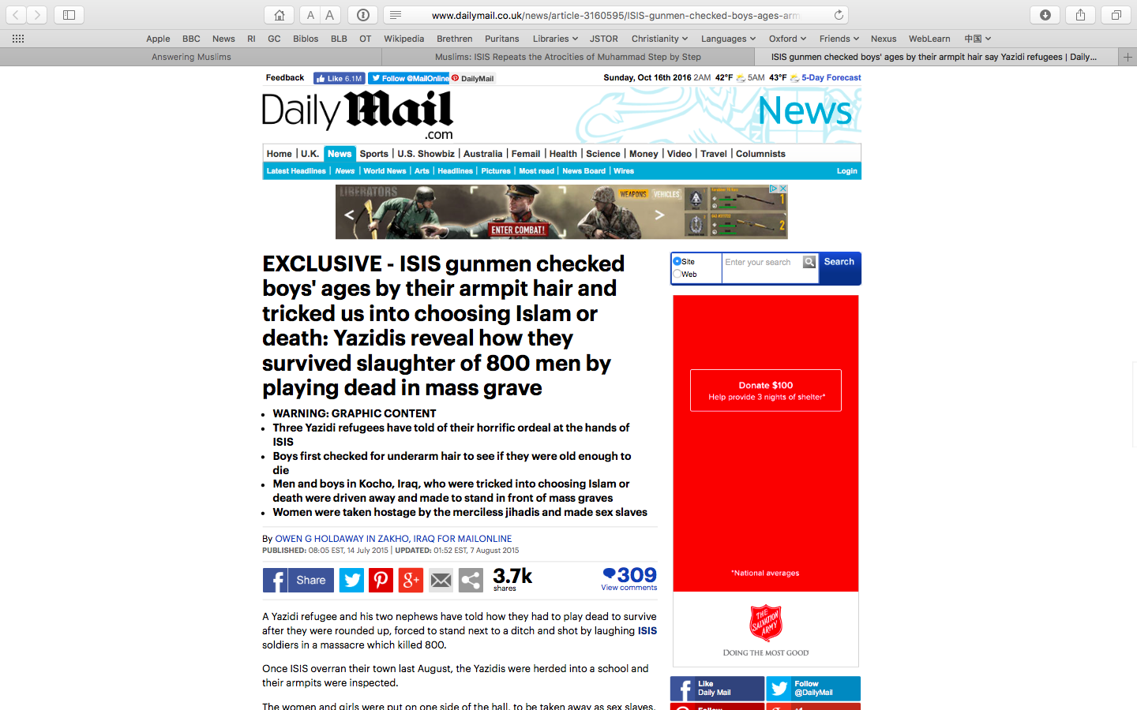

Slide 20
1

Slide 21
2

Slide 22
3

Slide 23
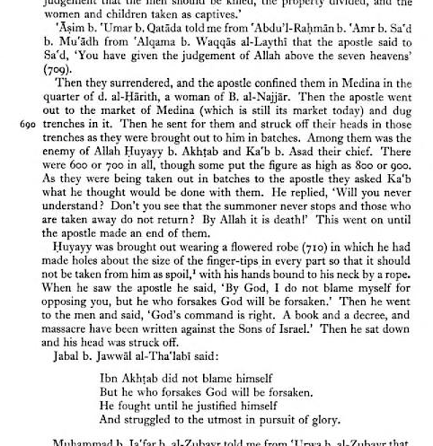
1. Killed in trenches

Slide 24
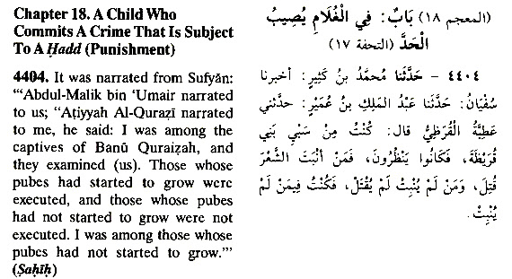
2. Boys checked for pubic hair

Slide 25
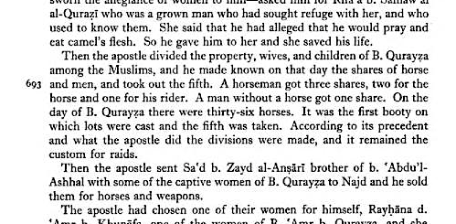
3. Women taken as slaves

Slide 26
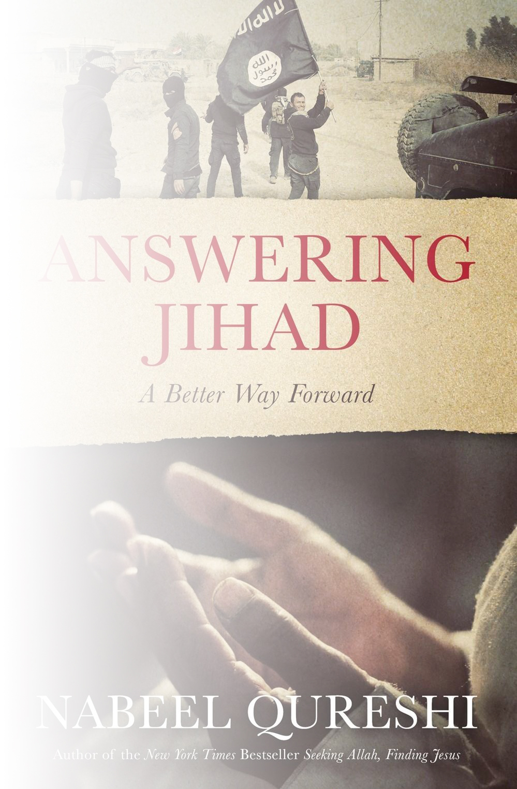
“Even though Muslims are often raised with the teaching that ‘Islam is the religion of peace,’ when they study the texts for themselves, they are faced with the reality that Muhammad and the Quran call for jihad. They will stand at the crossroads for only so long before they choose what path they will take—apostasy, apathy, or radicalization.”
—Nabeel Qureshi

Slide 27
“[A]lthough some might argue that your foreign policies are the extent of what drives our hatred, this particular reason for hating you is secondary […] The fact is, even if you were to stop bombing us, imprisoning us, torturing us, vilifying us, and usurping our lands, we would continue to hate you because our primary reason for hating you will not cease to exist until you embrace Islam.”

Slide 28
“So you can continue to believe that those ‘despicable terrorists’ hate you because of your lattes and your Timberlands, […] or you can accept reality and recognize that we will never stop hating you until you embrace Islam”
—From Dabiq, ISIS’s English-language magazine

Slide 29
“Your secular liberalism has led you to tolerate and even support ‘gay rights,’ to allow alcohol, drugs, fornication, gambling, and usury to become widespread […] As such, we wage war against you to stop you from spreading your disbelief and debauchery […] You’ve made it your mission to ‘liberate’ Muslim societies; we’ve made it our mission to fight off your influence and protect mankind from your misguided concepts and your deviant ways of life.”
—From Dabiq, ISIS’s English-language magazine

Slide 30
Roadmap
What is Islam?
Radical Islam and the West
What can Christians do?

Slide 31
What can Christians do?
Weep
Pray
Befriend
Go

