Slide 1
Tough Topics: Class 5
Is God Anti-Gay?

Slide 2
A tale of two narratives…

Slide 3
Roadmap
Culture’s narrative
Christianity’s narrative
Nitty-gritty

Slide 4
Where are we?
Timeline: Key events in the American gay rights movement

Slide 5
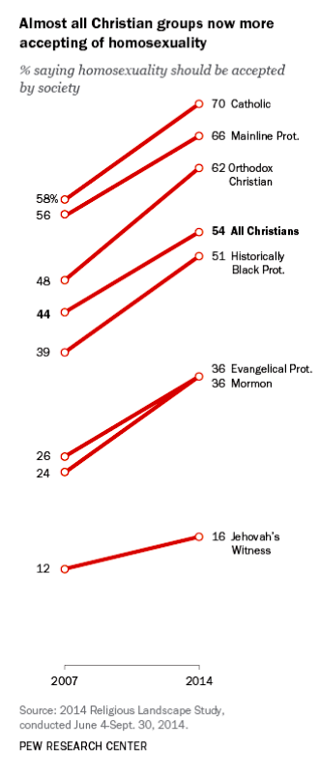

Slide 6
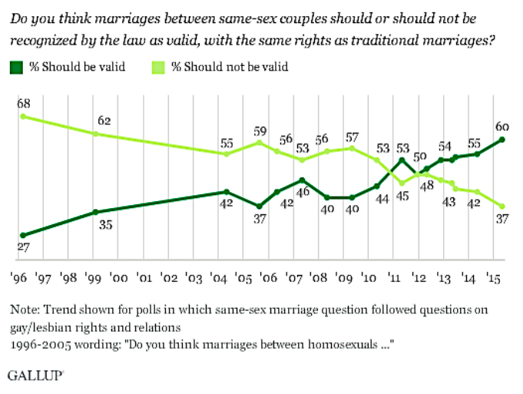

Slide 7
How we got here
Modern views on sexuality are a bit like a(n) island.

Slide 8
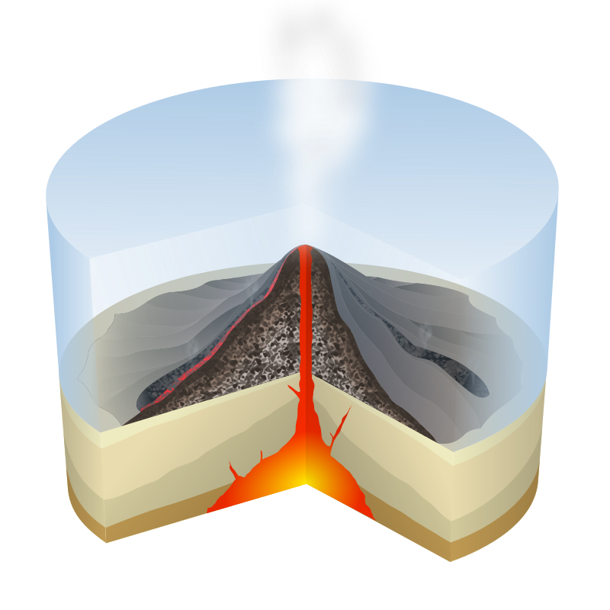
Beneath the surface:
Centuries of societal and ideological change

Slide 9
How we got here
A historical snapshot: The Enlightenment
Pre-Enlightenment: We know objective truth by divine revelation.
Enlightenment: We know objective truth by human reason.
Post-Enlightenment: There is no objective truth!

Slide 10
How we got here
Where does that leave us?
Radical individualism
We become our own source for determining…
…what is true.
…what is right and wrong.
…what produces human flourishing.

Slide 11
What it means
Individuality creates…
…a new ultimate value: freedom.
…a new self-created identity.
…a new ultimate value: authenticity.

Slide 12
“Modern authenticity encourages us to create our own beliefs and morality, the only rule being that they must resonate with who we feel we really are. The worst thing we can do is to conform to some moral code that is imposed on us from outside—by society, our parents, the church, or whoever else. It is deemed to be self-evident that any such imposition would undermine our unique identity … The authentic self believes that personal meaning must be found within ourselves or must resonate with our one-of-a-kind personality.”
—Jonathan Grant

Slide 13
Roadmap
Culture’s narrative
Christianity’s narrative
Nitty-gritty

Slide 14
Creation

Slide 15
How did God make us?
God made us.
What does this mean…
…for identity?
Our identity is not created but discovered. The more we come to know Jesus, the more we come to know ourselves!

Slide 16
How did God make us?
God made us.
What does this mean…
…for freedom?
True freedom is found in being in right relationship with Jesus.

Slide 17
“You have made us for yourself, O Lord, and our hearts are restless until they find their rest in you.”
—Augustine

Slide 18
How did God make us?
God made us embodied beings.
“Our culture says: Your psychology is your sexual identity—let your body be conformed to it.”
“The Bible says: Your body is your sexual identity—let your mind be conformed to it.”
—Sam Allberry
God made us sexual beings.

Slide 19
How did God make marriage?
Marriage is grounded in the complementarity of the sexes.

Slide 20
“The man said, ‘This is now bone of my bones and flesh of my flesh; she shall be called “woman,” for she was taken out of man.’ That is why a man leaves his father and mother and is united to his wife, and they become one flesh.”
—Genesis 2:24
(NIV2011, emphasis added)

Slide 21
“It is this sexual difference that accounts for the depth of union between the man and woman. Eve was created out of Adam: made from his body. Their one-flesh union is therefore something of a re-union, joining together what had originally been one.”
—Sam Allberry

Slide 22
How did God make marriage?
Marriage is between a man and a woman.
Marriage images God.

Slide 23
Fall

Slide 24
Romans 1: Sin affects…
…our hearts
…our minds
…our bodies

Slide 25
The Fall and homosexuality
The Bible is perfectly clear in what it says…

Slide 26
The Fall and homosexuality
…and perfectly nuanced in what it doesn’t say.

Slide 27
The Fall and homosexuality
It doesn’t say…
…that we can pick our struggles.
…that same-sex attraction is caused by specific personal sin.
…that homosexuality is worse than other sins.
…that God promises to change a person’s sexual orientation.

Slide 28
Salvation

Slide 29
Salvation
The gospel: Wonderful news… for everyone
How we come: In total surrender
While we wait

Slide 30
“God has the power to change [one’s] orientation, but he hasn’t promised to and that has not been my experience. Research suggests that complete change from exclusively homosexual desires to exclusively heterosexual ones is very rare. While supporting the right of anyone to seek help to change if they wish, our emphasis needs to be on encouragement to be godly and content in current circumstances. […] It’s important to recognise that very often God’s power is seen, not by him removing our temptations and difficult circumstances, but by giving us the strength to persevere and live for him in the midst of them. Understanding this profound principle of God’s power being seen in weakness will transform our attitude towards all our battles as believers. We will then be able to see our struggles, including the experience of living with same-sex attraction, not just negatively, but also positively.”
—Vaughan Roberts
(Emphasis added)

Slide 31
Salvation
The gospel: Wonderful news… for everyone
How we come: In total surrender
While we wait
What we’ll be

Slide 32
Roadmap
Culture’s narrative
Christianity’s narrative
Nitty-gritty

